Slide 1
Language Weaver Overview
Swamy Viswanathan, Vice-President of Products
May 19th 2010

Slide 2
Language Weaver At-A-Glance
Founded | 2002
Employees | 100+
Locations | Los Angeles (HQ), Washington DC, Boston, San Francisco, Paris, London, Brussels, Tokyo & Cluj, Romania
Markets Served | Digital Content Customer Support Government Intelligence Language Weaver delivers trusted human communication solutions through automated language translation
Management Team | Mark Tapling, CEO Daniel Marcu CTO Kevin Knight Chief Scientist William Wong, VP of Engineering Swamy Viswanathan, VP of Products

Slide 3
Strategies for Effective Global publishing, Communication & Self Service
Publish all relevant information
You cannot predict who will find what information useful
Make the information available across multiple channels
Each demographic prefers its own channels for consumption of content and communication
Make the information available in the language of the customer
The web is now increasingly populated by non-english speaking users. Make content findable in their own language
Notes:
Publish all relevant information: Making more information available online is not just a symbol of openness. Rather, this makes sure that the long tail of its customer base can find the information they need to support themselves.
Make the information available across multiple channels: It is impossible for a company to predict precisely what information is needed across which channel – so making the information available across the Web, mobile and various social platforms ensures that customers can find information where they live and when they need it.
Make the information available in the language of the customer: Businesses are very good at launching products in multiple languages, but typically offer support in only one or two languages. This breaks a crucial brand promise to a consumer. Translating pre-sale information signals to the customer that a business is ready to do business in their language. When support content is not available in that language, the promise to do business in their language is broken. To avoid this, make sure that all the information is available in all of the languages that are relevant and important to the customer base.
I will focus mainly on #3

Slide 4
Options for Translation
Human translation
Professional translator fluent in source & target language performs translation of content
Automated translation + post-edit
Output from automated translation software is reviewed by human fluent in target language before content is published
Fully automated translation
Content from automated translation published without human oversight

Slide 5
Selecting the Best Translation Option For A Content Type
Quality
Domain Specific: Marketing
High
Advertising
Human Review Recommended
Publisher Content
Software User Interface
Marketing Content
Product Documentation
Newsletters
Blogs
Training Materials
HR Documents
Branding
Appropriate for
Fully Automated Translation
FAQ
Product Alerts
Knowledge Base
Doc Management
Email Support
Email
User Forums
Instant Messaging
Alerts/Notifications
Chat
Domain Specific: Collaboration/IT
Domain Specific: Customer Support
User Reviews
Utility
Low
Task-Driven
High
Define your own TrustScore – the measure of utility for a content type

Slide 6
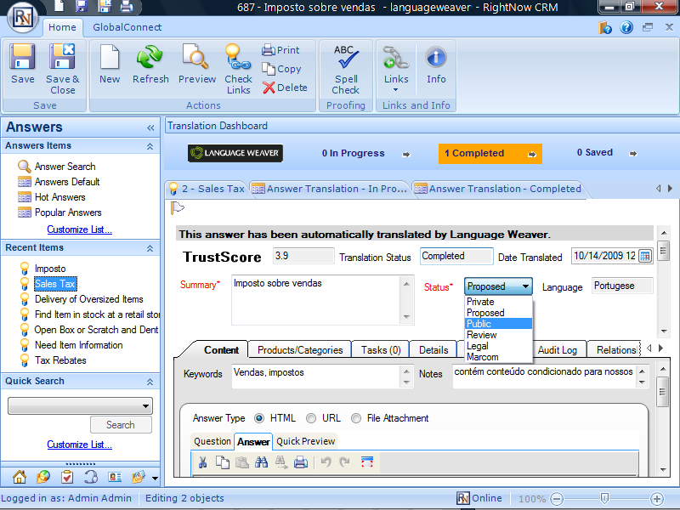
Where Language Weaver Fits
In a Knowledge Base Workflow:
Integrated as part of the publishing process for publishing FAQ’s, support docs etc.
Available product: GlobalConnect For RightNow Answers
In a support communication workflow:
Integrate with email and chat to translate inbound and outbound messages
Upcoming products: GlobalConnect for RightNow Incidents
In a web publishing / collaboration scenario:
Integrate with any content management system. Automatically translate, publish or share based on TrustScore
Available products: LanguageWeaver web products and API
Empower monolingual speakers to become multi-lingual publishers, content managers and communicators
http://www.languageweaver.com/flash/GlobalConnectDemo.html

Slide 7
Thank you!
Swamy Viswanathan Vice-President of Products +1-310-437-7300 swamy@languageweaver.com

